Slide 1
Finance Project
By
Yash Gupta
Polashi Bordoloi

Slide 2
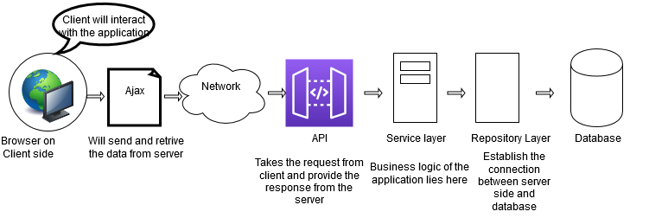
Application architecture:

Slide 3
Web Services and its usage:
A web service is a piece of code which uses a standardized XML messaging system and makes itself available over the internet for direct application-to- application interaction.
Web services are not specific for programming language or OS. It is built on top of the standards such as HTTP, Java, HTML, and XML.
A web service is called when a user summons an XML request and it sends the response to it through an XML message.

Slide 4
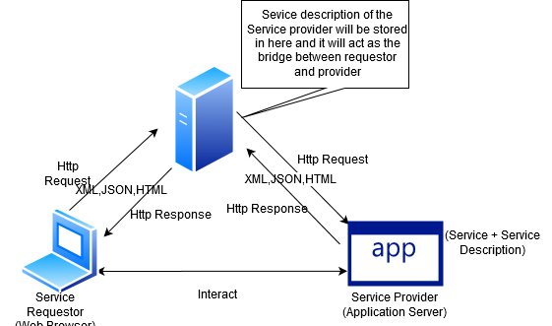
...contd

Slide 5
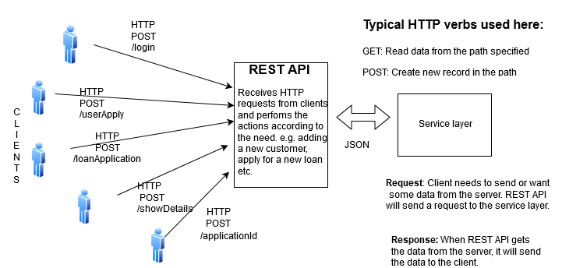
REST API:

Slide 6
REST API URL:
/addCustomerComplete:
addCustomerFullDetail(): The customer information along with bank details will come from client side and it will send the data to Service Layer.
/approveLoan:
approveLoan(): New loan application request will go to the service layer which will be sent to the manager though email.
/repayLoan
repaymentForLoan(): Unique verfication Id will be required to repay for any particular loan application.
/getCustomerAID
getCustomerByApplicationId(): Customer details will be fetched based on the unique applicationId.

Slide 7
/getCustomerCID:
getCustomerByCustomerId(): Customer details will be fetched for the unique customer ID.
/getDepositMoney
getBankDeposit(): It will credit the money to user’s bank account.
/getLoanApplicationStatus:
getLoanApplicationStatusWise(): It will show the loan application Id based on the status of approval i.e, whether it’s approved, processing or not-approved.
/getLoanApplicationDate:
getLoanApplicationDateWise(): It will show the loan application Id based on the date of approval.
/getLoanApplication:
getLoanApplicationById(): It will show the details of loan application for a unique application ID.

Slide 8
/verifyUser:
userExist(): It will check whether the customer ID already exists or not and based on that actions will be taken.

Slide 9
REST Client:
It is a platform that can invoke a REST service API that is exposed for communication by any system or service provider.
Postman is an example of REST Client, where we can add, remove parameters, headers, tests and more. Displays all the information in a partitioned way so that developer can track exactly according to the API call.

Slide 10
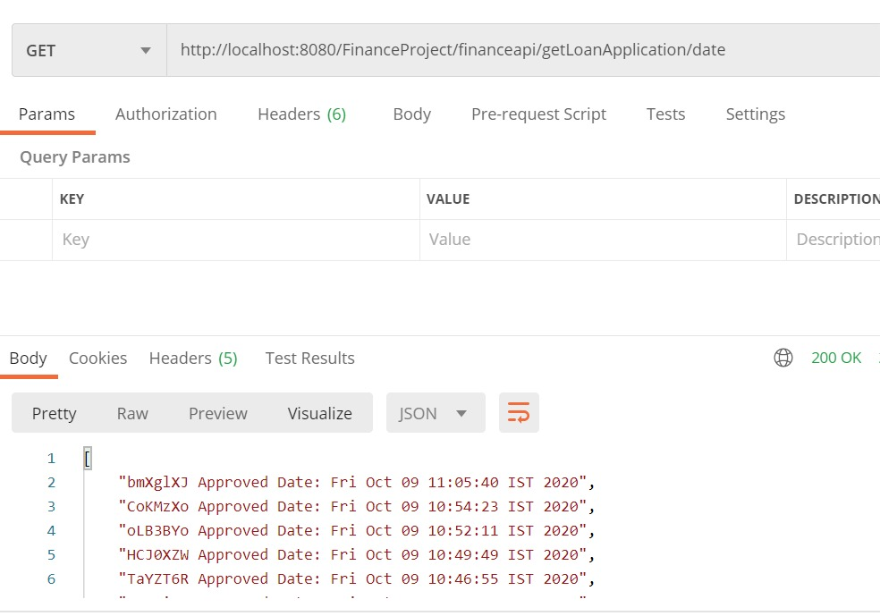
Postman:

Slide 11
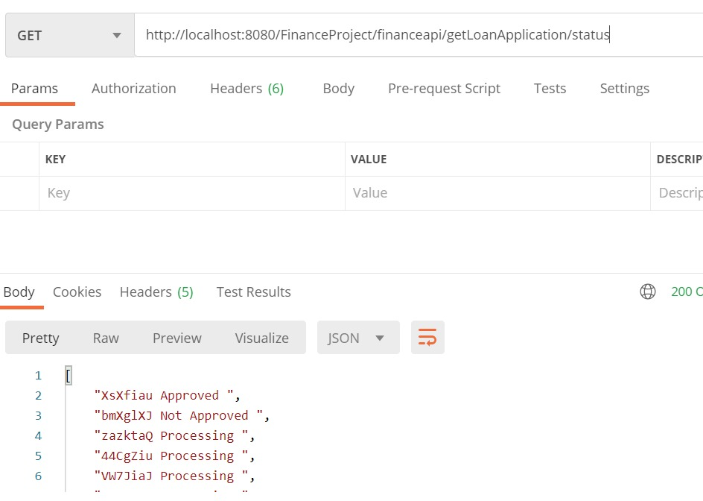

Slide 12
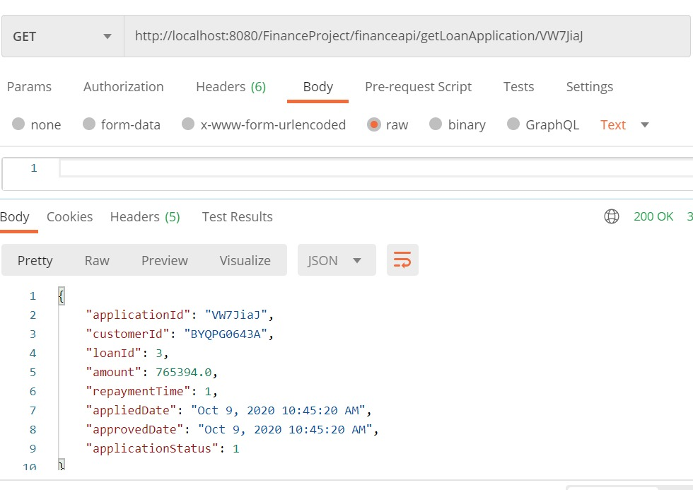

Slide 13
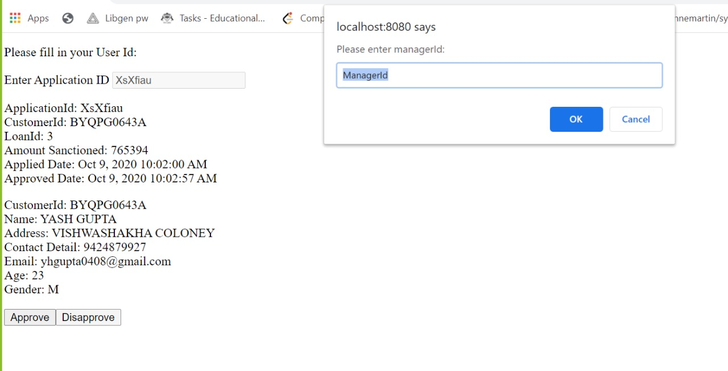

Slide 14
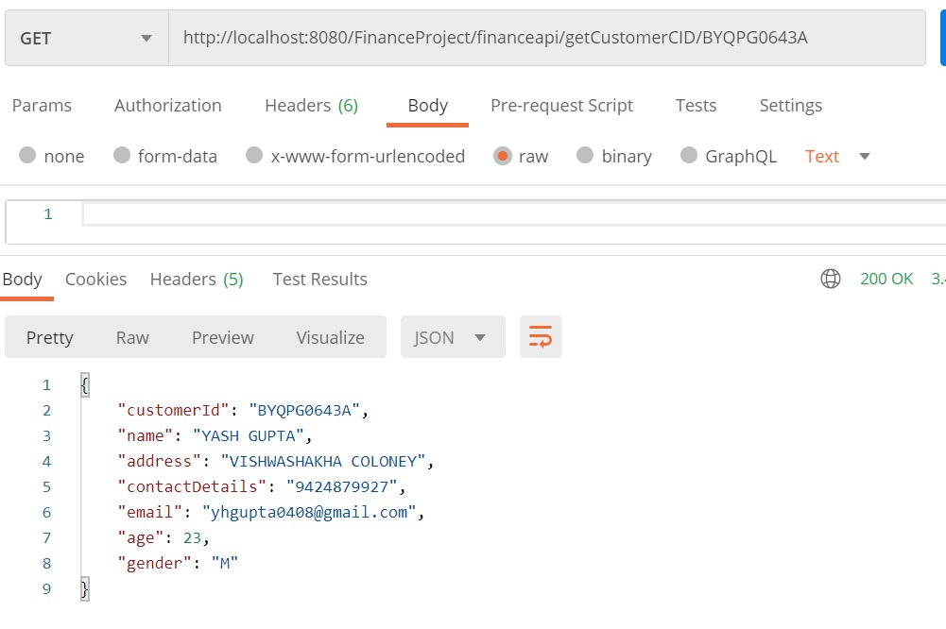

Slide 15
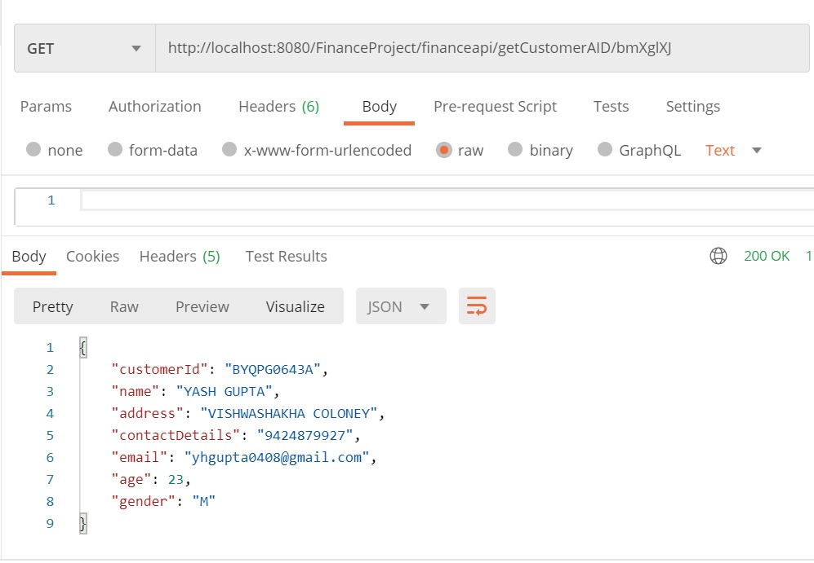

Slide 16
Javascript client:
Javascript client runs on the client machine that is browser itself.
It makes possible to allow some user interactions, e.g, changing the DOM, adding events to html elements, etc.
It adds validation and functionality for user events.

Slide 17
AJAX:
Ajax is the use of XMLHttpRequest object to communicate with servers. It can send and receive information in various formats, including JSON, XML, HTML, and text files.
AJAX allows web pages to be updated asynchronously by exchanging small amounts of data with the server behind the scenes.
AJAX is commonly used to update features like status and notification bars, online forms, comments sections, and surveys and polls.

Slide 18


